Slide 1
Computer Organization and Architecture
Dr. Hammad Afzal
26th Oct, 2010

Slide 2
Lecture 8
Instruction Sets (contd ..)
Characteristics and Functions
Chapter 9 of William Stallings's Book: Computer Organization and Architecture

Slide 3
Types of Operation
Data Transfer
Arithmetic
Logical
Conversion
I/O
System Control
Transfer of Control
Notes:
18

Slide 4
Data Transfer
Most fundamental type of machine instruction.
Specify
Source and Destination (register, memory or top of the stack)
Amount of data
Mode of addressing of operand
Notes:
19

Slide 5
Data Transfer
May be different instructions for different movements
e.g. IBM 370
Or one instruction and different addresses
e.g. VAX
Notes:
19

Slide 6
Arithmetic
Add, Subtract, Multiply, Divide
Signed Integer, Floating point and packed
May include single operand instructions
Negate, Increment and Decrement
Notes:
20

Slide 7
Shift and Rotate Operations
Operations performed on bits, also referred as “bit twiddling”.
Based on Boolean operations
Bitwise logical operations e.g. AND, OR
Shifting and rotating functions,
Logical shift: On one end, bit is lost, on other end, 0 is added. (Example usage from book)
Arithmetic shift: Signed bit is retained.

Slide 8
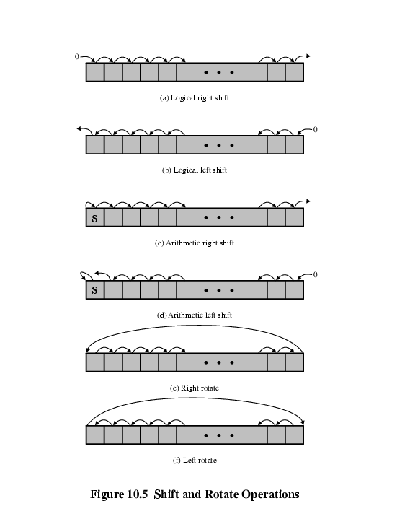
Shift and Rotate Operations

Slide 9
Conversion
Change the format of data
E.g. Binary to Decimal
Translate from EBCDIC to IRA (read details from book).
Notes:
22

Slide 10
Input/Output
Variety of approaches.
Isolated programmed I/O
Memory mapped programmed I/O.
May be done by a separate controller (DMA)
Will be covered with Chapter 7
Notes:
23

Slide 11
Systems Control
Privileged instructions
CPU needs to be in specific state
Processor in privileged state, or executing in privileged area of memory.
For operating systems use
Notes:
24

Slide 12
Transfer of Control (1)
Update program counter to alter sequence of execution
Reasons
Iteration
Selection
Functions
Notes:
25

Slide 13
Transfer of Control (2)
Branch (or jump):
Skip
Subroutine call
Notes:
25

Slide 14
Transfer of Control (3)
Branch (or jump):
has one of its operands as address of next instruction to be executed.
Conditional Branch. BRP X, BRN X, BRZ X, BRO X
Can be forward or backward
Unconditional branch.
e.g. branch to x if result is zero
Notes:
25

Slide 15
Transfer of Control (2)
Skip
Skips the instruction and goes to the next instruction.
Address implied (next address)
Can perform other tasks.
e.g. increment and skip if zero
ISZ Register1
Example from Book
Notes:
25

Slide 16
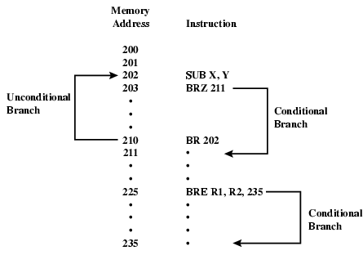
Branch Instruction

Slide 17
Procedure Call
A procedure is a self-contained computer program that is incorporated into a larger program.
The processor is asked to go and execute entire procedure and then return to the point from which the call took place
Economy and Modularity
Notes:
25

Slide 18
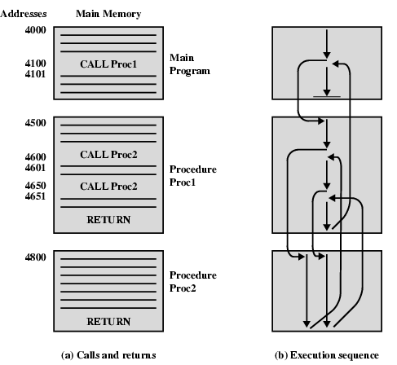
Nested Procedure Calls
Notes:
Slide to be included after this

Slide 19
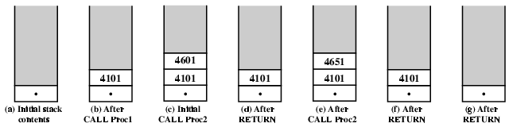
Use of Stack

Slide 20
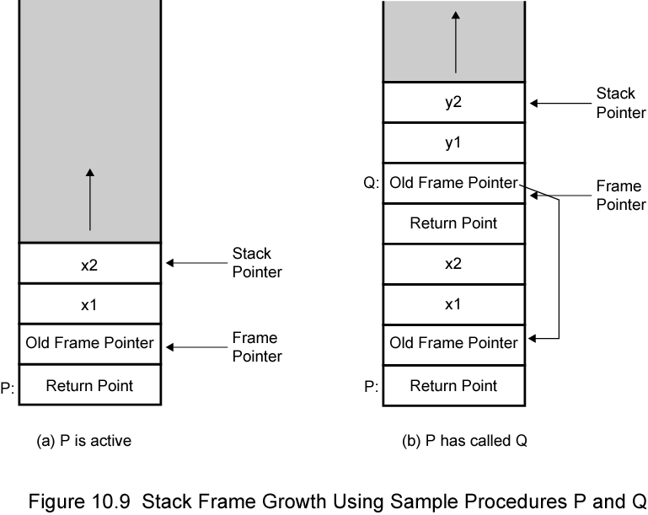
Stack Frame Growth Using Sample Procedures P and Q

Slide 21
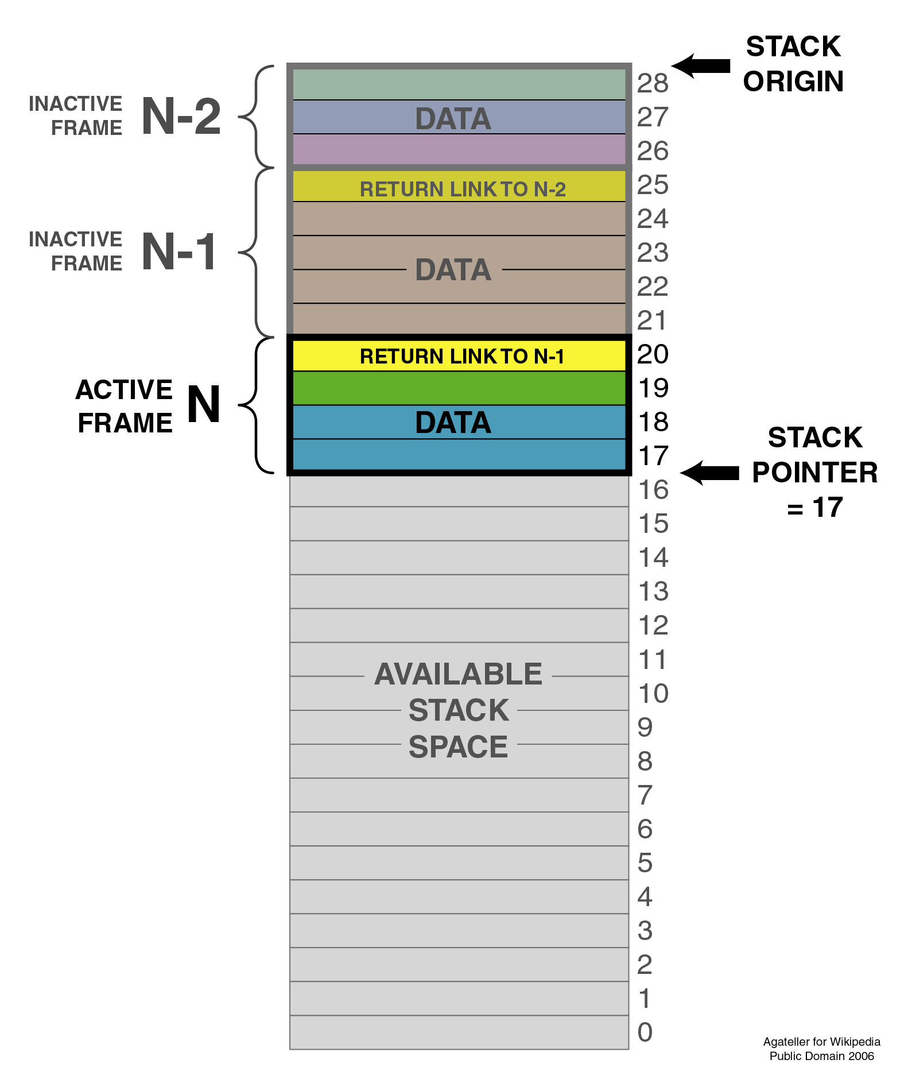

Slide 22
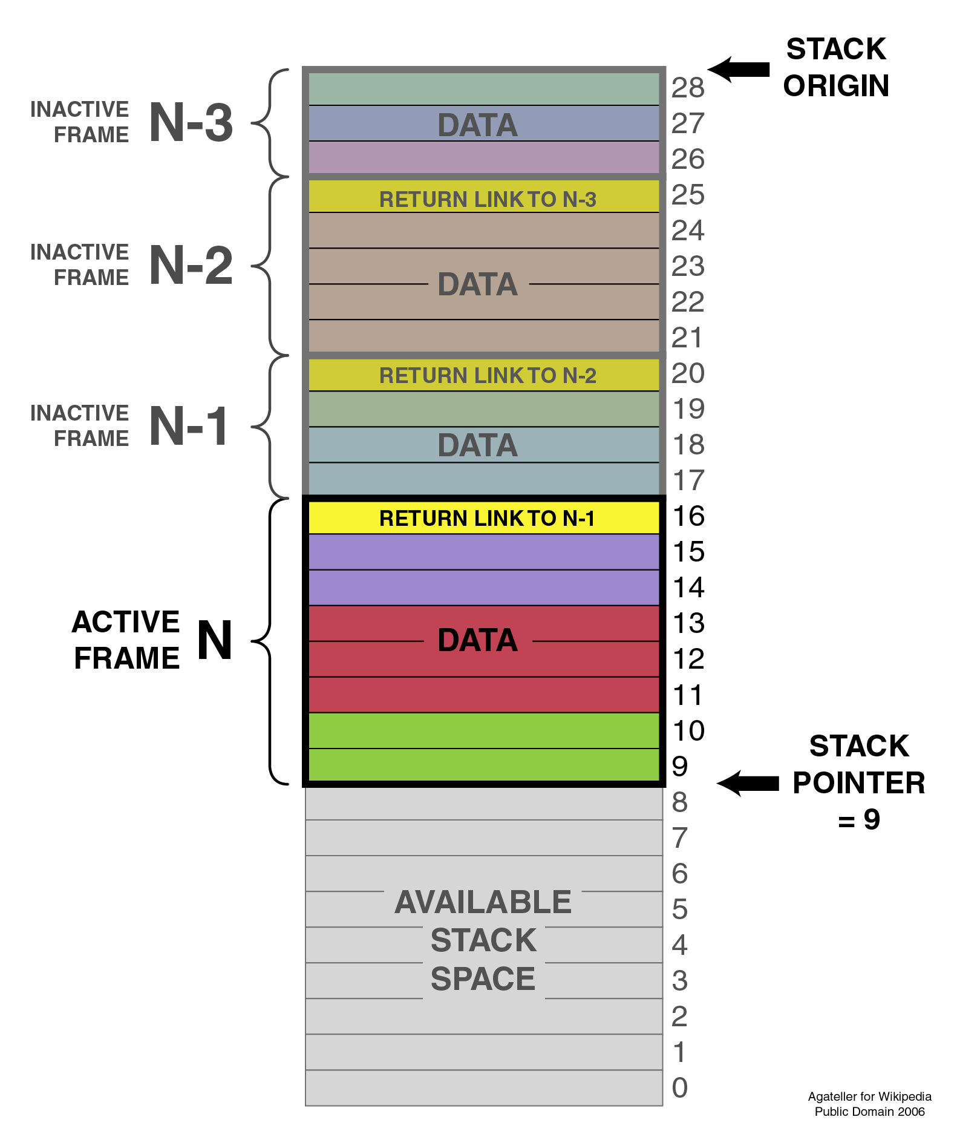

Slide 23
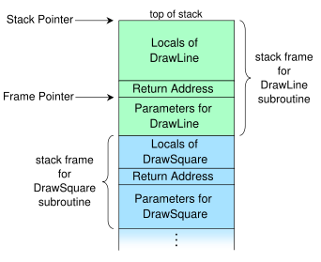

Slide 24
Byte Order (A portion of chips?)
What order do we read numbers that occupy more than one byte
e.g. (numbers in hex to make it easy to read)
12345678 can be stored in 4x8bit locations as follows
Notes:
27

Slide 25
Byte Order (example)
Address Value (1) Value(2)
184 12 78
185 34 56
186 56 34
186 78 12
i.e. read top down or bottom up?
Notes:
28

Slide 26
Byte Order Names
The problem is called Endian
The system on the left has the least significant byte in the lowest address
This is called big-endian
The system on the right has the least significant byte in the highest address
This is called little-endian
Notes:
29

Slide 27
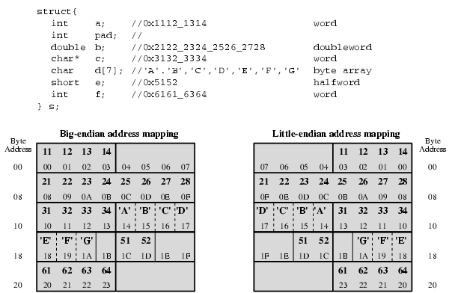
Example of C Data Structure

